Slide 1


NEXT GEN EMPLOYABILITY PROGRAM
CREATING A FUTURE-READY WORKFORCE
Student Name :
RAVITEJA LINGALA
Student ID :
College Name :
STU66a0cba95a0e21721813929
MLR INSTITUTE OF TECCHNOLOGY

Slide 2
CAPSTONE PROJECT SHOWCASE
Project Title
P5- BIDDING ZONE
Abstract | Problem Statement | Project Overview | Proposed Solution | Technology Used | Modelling & Results | Conclusion |

Slide 3
Abstract
Objective: To develop a web-based auction platform where users can list items and
participate in real-time bidding.
1
2
Features: Includes user registration, item listing, and live bidding.
3
Technology: Built using Node js, Express.js, MongoDB and mangoose for the backend. React.js for the frontend.
4
Outcome: Provides a transparent, efficient, and adaptable digital auction environment for various use causes.

Slide 4


Problem Statement
In the digital age, traditional in-person auction systems face limitations, including geographical constraints, limited participant reach, and logical complexities.
As a result, there is an increasing demand for a modern online auction platform that enables buyers and sellers from different locations to participate in real-time, competitive bidding.
Existing online auction solutions often struggle with providing smooth user experiences, secure transactions, and scalable performance.

Slide 5

Project Overview
This project is an Online Auction.
The main goal of this project is to create a web application that facilitates online auctions, allowing users to list products and bid in real time.
In this project, there are some key modules used, such as user authentication, bid history, and item listing.
The Online Auction project works with a lot of technologies. React.js, Express.js, and MongoDB for frontend, backend, and database purposes, respectively.
This project enables sellers to reach a broader audience and buyers to participate in competitive bidding, enhancing fairness and transparency in digital auctions.
An Engaging UI ensures a smooth and interactive experience, keeping the audience actively involved.

Slide 6
Proposed Solution
This project proposes a modern online auction platform designed for real – time , competitive bidding with a focus on user experience, security, and scalability.
The platform will provide instant bid updates, while a React frontend will ensure a seamless interface for both buyers and sellers. Secure payment integration will safeguard transactions and user data.
An Express.js backend will support high traffic with efficient data handling and scalability, and analytics tools will enable ongoing improvements.
This solution aims to deliver a secure, engaging, and reliable auction experience for global users.

Slide 7
Technology used
Frontend: React.js for building dynamic user interfaces, Bootstrap for styling.
Backend: Node.js and Express.js for server-side logic and MongoDB for database management.
Authentication: (JWT)JSON Web Tokens for secure user authentication and authorization.
Development Tools: Axios for HTTP requests and tools for version control, testing, and deployment.

Slide 8
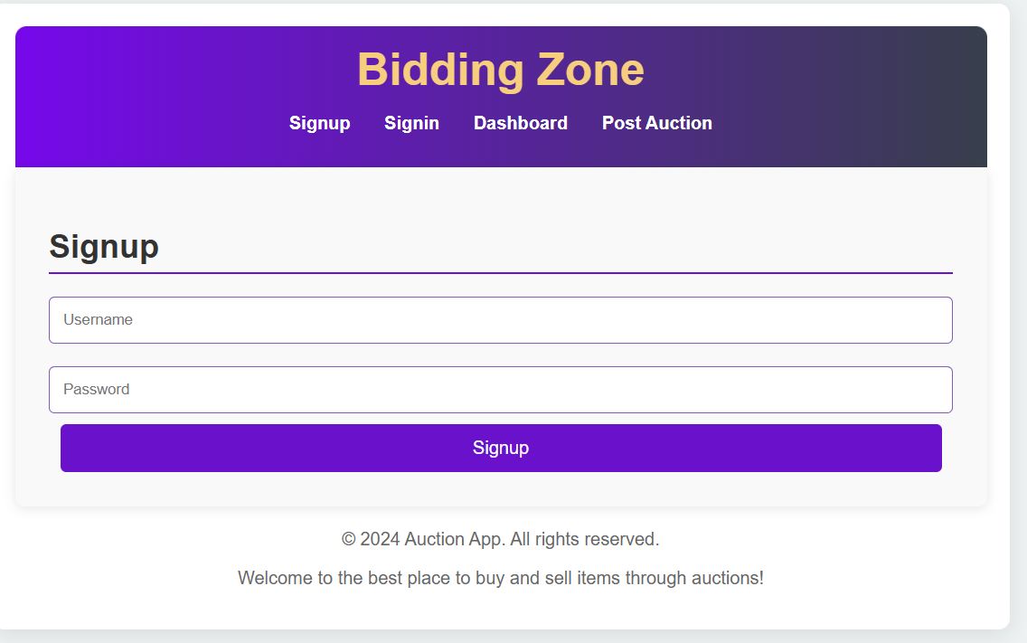
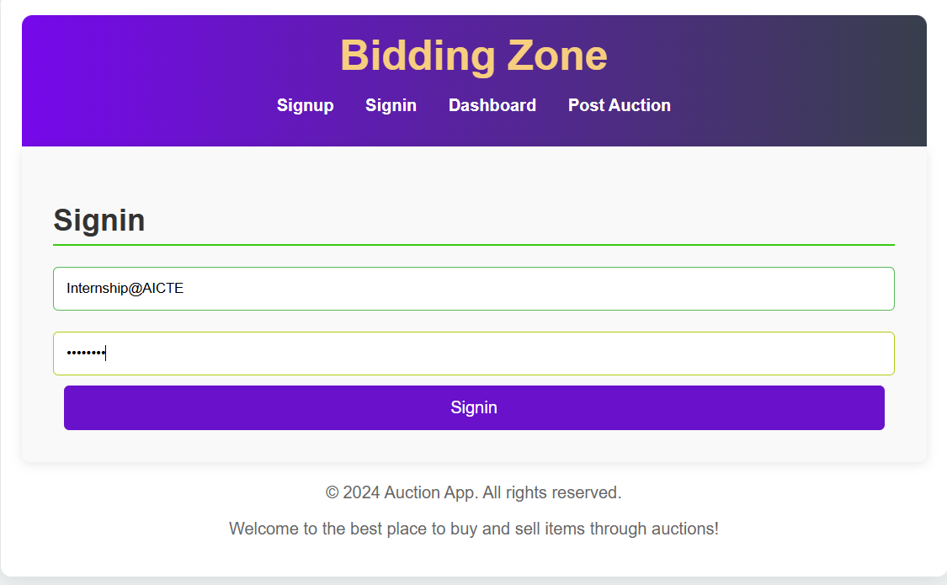
Modelling & Result

Slide 9
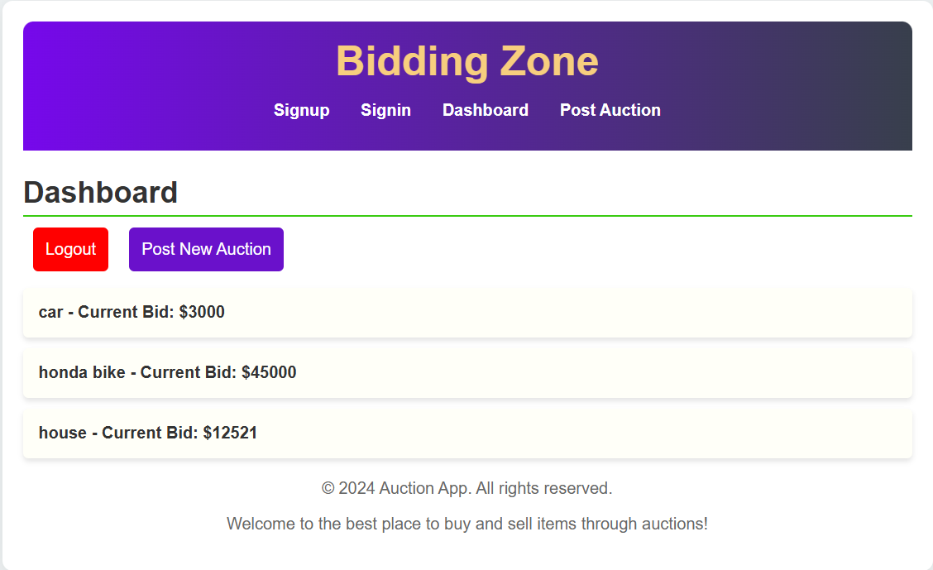
Modelling & Result

Slide 10
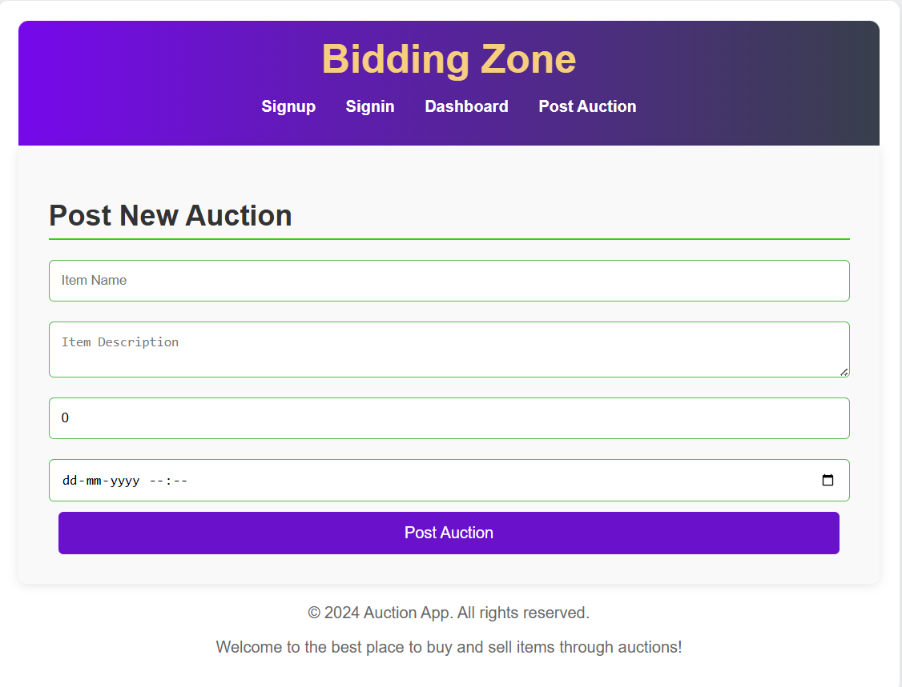
Modelling & Result

Slide 11

Conclusion
The Online Auction and Bidding System provides a robust and interactive platform that replicates the traditional auction process in a digital format. By integrating real-time bidding, user-friendly interfaces, and a reliable tech stack, the project ensures a seamless experience for both buyers and sellers.
This system not only enhances user engagement but also promotes transparency, competitiveness, and efficiency—making it a valuable solution for modern e-commerce and service-based marketplaces.

Slide 12


Notes:
Thank You !!

